Slide 1
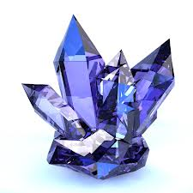
Year 8 Geology Investigation
Does cooling rate affect the size of crystals formed?

Slide 2
Background
What are crystals?
Where can they be found?
How are they formed?
Hint: you read about this yesterday in your textbook – if you can’t remember, re-read page 280

Slide 3
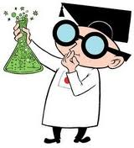
How will you grow crystals?
Your group will get a copper sulphate solution which you will heat up
You then need to cool your solution down – you need to come up with ways to make it cool down quickly or more slowly
You then need to work out how to measure the size of the crystals that form

Slide 4
Hypothesis
Your hypothesis is a prediction of what you think will happen when you cool the copper sulphate solution down
When I cool the copper sulphate solution down _____________, I expect the crystals that form to be ____________.

Slide 5
The independent variable
The factor in the experiment that you change
In this experiment you are changing: ______________________

Slide 6
The dependent variable
The factor in the experiment that you measure
In this experiment you are measuring: ______________________

Slide 7
The controlled variables
The factors in your experiment you will keep the same:
___________________
___________________
___________________

Slide 8
Materials

Slide 9
Method

